Slide 1
Machine Learning1 Assignment

Slide 2
Chapter- 01
Problem Statement and Objective

Slide 3
Problem Statement
The latest worldwide financial crisis restored a sharp enthusiasm toward both academic and strategy circles on the part of asset costs and specifically lodging costs clinched alongside monetary movement.
Vargas and silva (2008) contend that lodging costs alterations assume a paramount part in the determination of the stage of the business cycle.
Recently, a few writers scope to experimental discoveries that house costs can make instrumental molding to determine the yield. (Forni etc, 2003; stock and Watson, 2003; Gupta Furthermore Das, 2010; das etc, 2009; 2010; 2011; Gupta and Hartley, 2013).
Some of the approaches taken by researchers-
Rapach Furthermore strauss (2007) use an auto regressive dispersed slack (ARDL) model framework, holding 25 determinants with conjecture genuine lodging cost development to the unique states of the elected Reserve’s eighth region.
Gogas and Pragidis (2011) utilize the hazard premium ascertained Likewise those Contrast the middle of Different long haul enthusiasm rates and the agents’ desires over future fleeting rates as information variable to foreseeing what's to come heading for house costs.
Gupta and Das (2010) also forecast the recent downturn in real house price growth rates for the twenty largest U.S. states. The authors use Spatial Bayesian VARs (BVARs), based only on monthly real house price growth rates, to forecast their downturn over the period 2007:01 to 2008:01.

Slide 4
Researchers have constantly tried to make some model using different techniques to predict the house pricing due to various reasons but we can broadly divide it into 2 parts
1. For broker/ bank
2. For Customer
When the broker wants to sell or rent a house, he should be able to set a proper price for that. A price which is not too low so that he can earn profit, and it should not be that high so that the customer rejects the offer.
When the Bank decides to give a Home Loan, it checks if the price of the house to which it is giving loan is appropriate or not.
When a customer wants to buy a house, he wants to know what should be his budget for the type and locality of the house that he wishes to buy or rent.
Link - https://www.google.com/url?sa=t&source=web&rct=j&url=https://www.ijitee.org/wp-content/uploads/papers/v8i9/I7849078919.pdf&ved=2ahUKEwiVub6T1M7pAhUHzDgGHTdpBeYQFjAAegQIAxAB&usg=AOvVaw1oiAhYYAeLu5dO10F_pBzN&cshid=1590397497804

Slide 5
Objective
To Build a Model to Predict the House pricing when some features are given to us using Multiple Linear Regression

Slide 6
Chapter- 02
Data Dictionary

Slide 7
Data Sets Description
We have 3 Data Set-
Train Data set
Validation Data set
Test Data set
Train Data = We will use this data to train our data.
Validation Data = We will use this data to validate different models.
Test Data= After Validation and selecting good models, we will in test the model with test Data.

Slide 8
Variables and Definitions
Id - id for houses(unique id for every house)
Date - Date of recording of data
Price - Price of the house
Bedrooms - Number of bedrooms in the house
Bathrooms - Number of bathrooms
Sqft_living – Living Area in Square feet
Sqft_lot - Area of whole Lot in Square feet
Floors - Number of floors
Waterfront - Indicates that the house have a water front or not
View – How is the view(rating)
Condition – How is the condition(rating)

Slide 9
Variables and Definitions
Grade – Overall Grade of the house(rating)
Sqft_above - Area of living minus the area of basement
Sqft_basement – Area Of The Basement
Yr_built – Year Builty
Yr_renovated – Year Of Renovation If Any
Zipcode – Zipcode Of The Area
Lat- Latitude Of The House
Long – Long Of The House
Sqft_living15
Sqft_lot15

Slide 10
Chapter- 03
EDA and Anomaly Correction

Slide 11
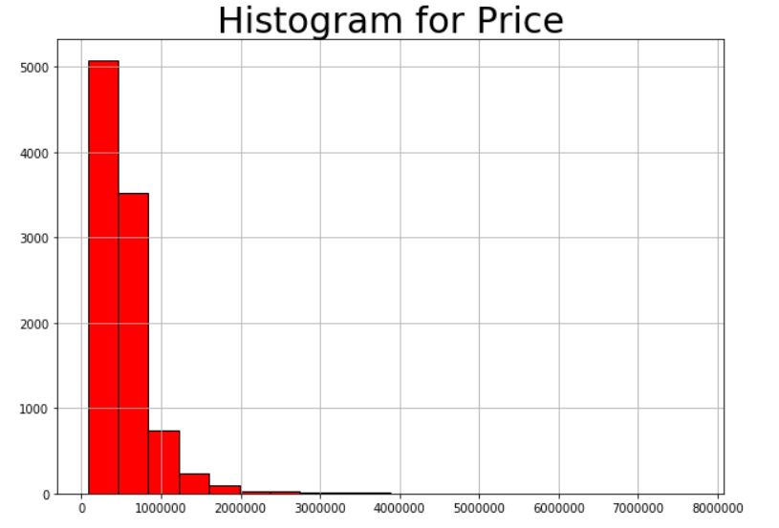
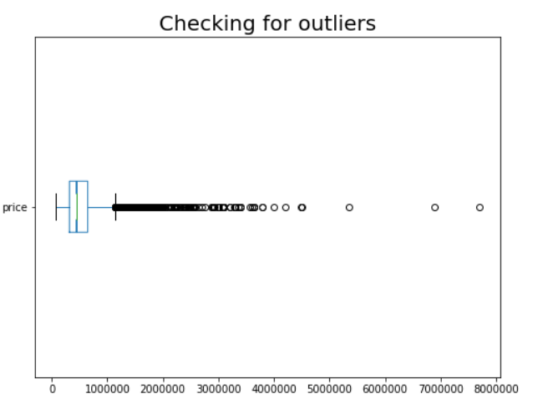
Univariate Analysis of Price
No Missing Value
Price Description-
count 9761
mean 542833.6
std 379777.9
Median 450000
We can see that price is highly right skewed
There are many outliers ( 522 in total )

Slide 12
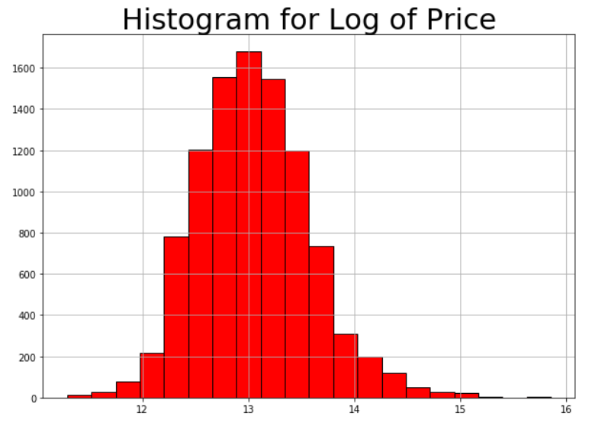
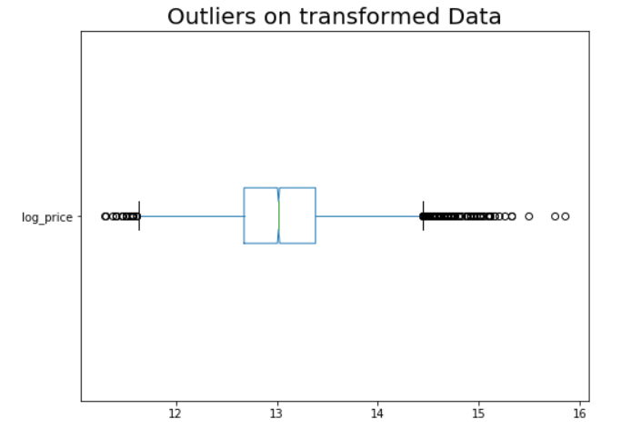
Distribution is more normal after applying log transformation
Number of outliers has drastically decreased (148)

Slide 13
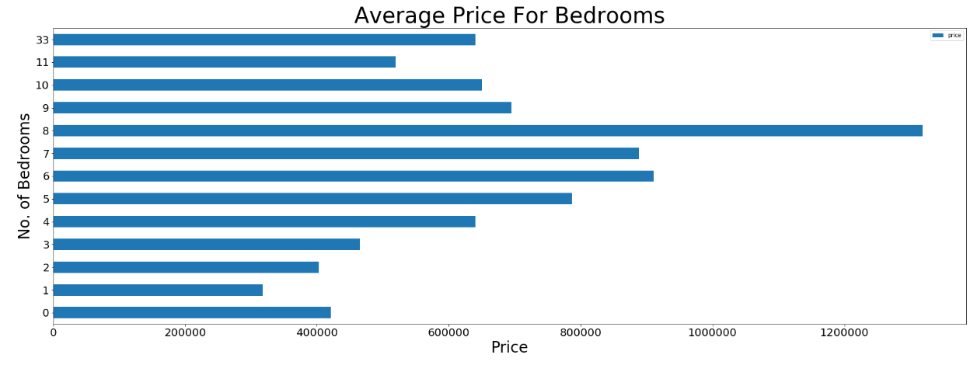
Analysis of Bedrooms
Bedrooms | Count
0 | 6
1 | 88
2 | 1255
3 | 4417
4 | 3094
5 | 755
6 | 116
7 | 17
8 | 7
9 | 3
10 | 1
11 | 1
33 | 1
Till 8 bedrooms average price is increasing with increase in bedrooms
Correlation - 0.3
This is not a proper data as after 11 it directly jumps to 33. There can be some typo error.

Slide 14
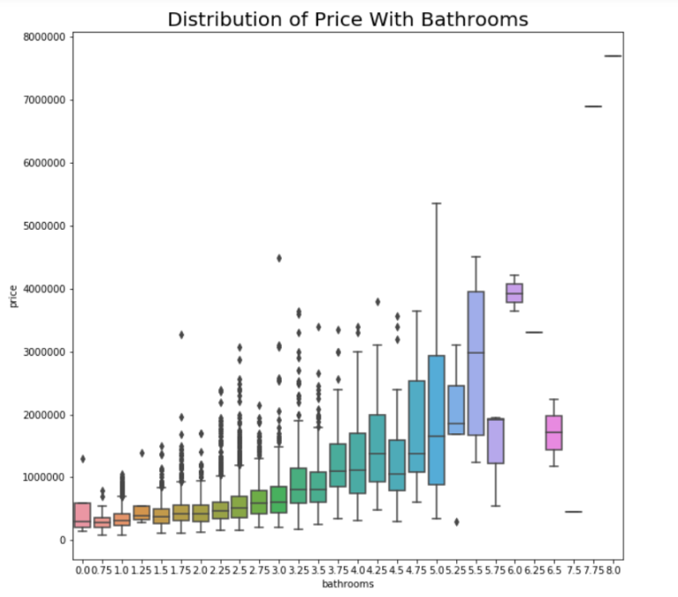
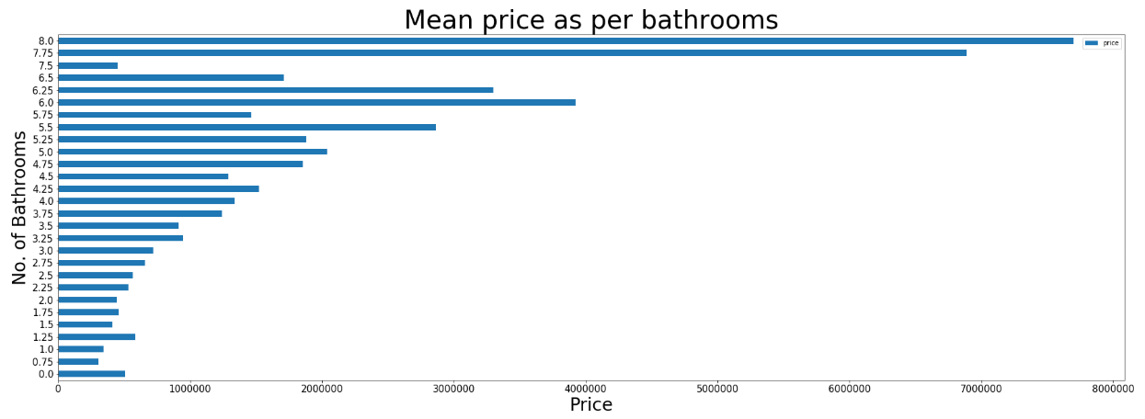
Analysis of Bathrooms
Correlation - 0.53
Price mean and median is significantly increasing with increase in Number of Bathrooms

Slide 15
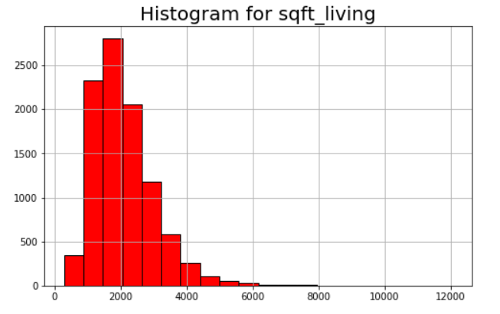
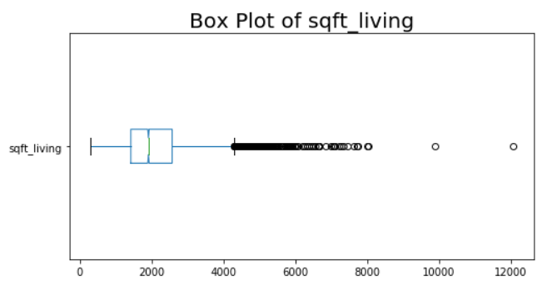
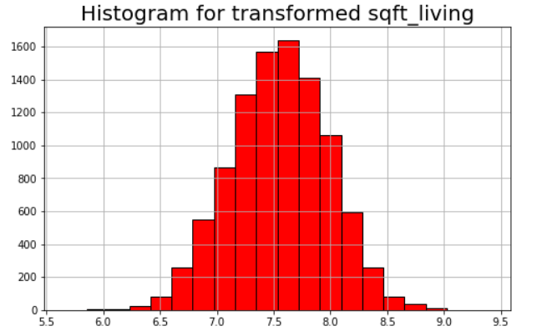
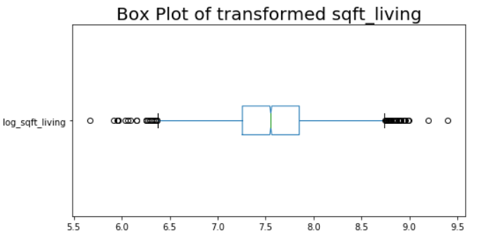
Analysis of sqft_living
Outliers-240
Outliers-51

Slide 16
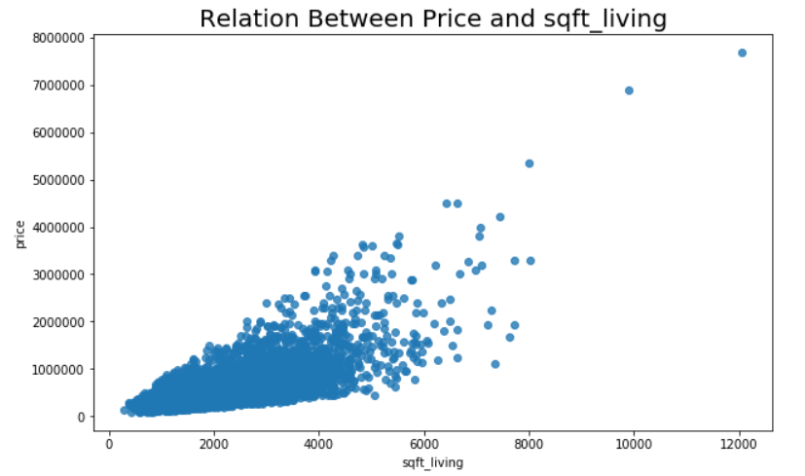
Correlation - 0.70
Highly Correlated

Slide 17
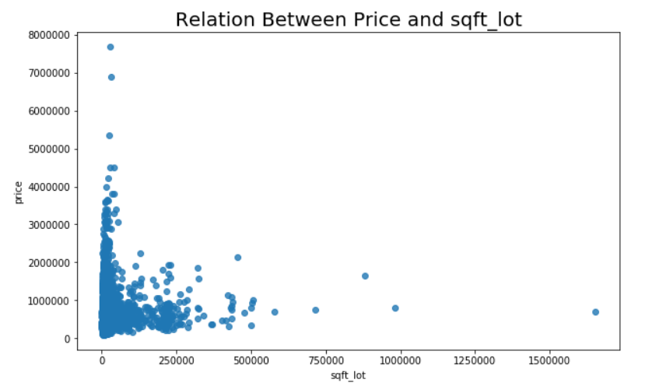
Analysis of sqft_lot
Correlation- 0.094
We cannot see any linear relationship between Price and sqft_lot

Slide 18
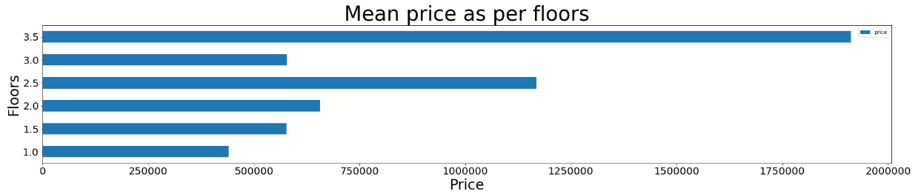
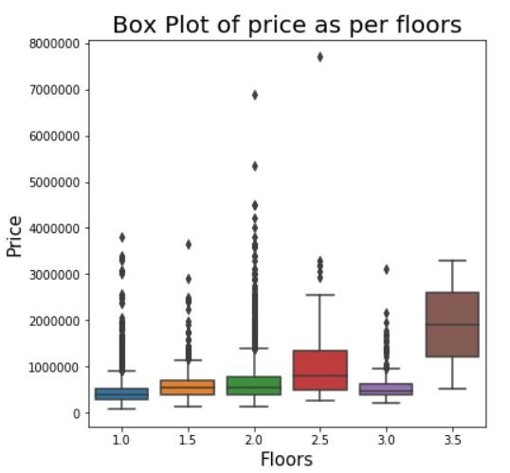
Analysis of Floors
Floors | Count
1 | 4862
1.5 | 867
2 | 3723
2.5 | 62
3 | 245
3.5 | 2
Correlation- 0. 263
We can see a slight correlation between Floors and Price from Box Plot and Bar Graph

Slide 19
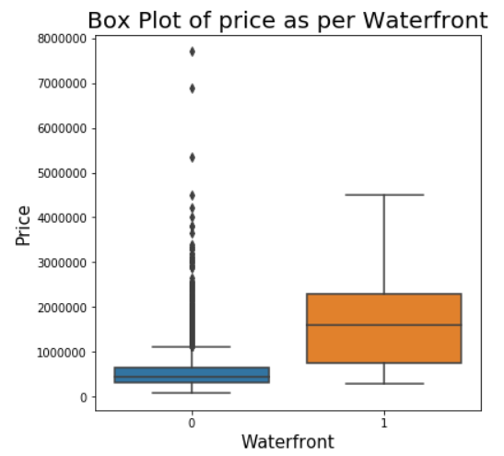
Analysis of Water Front
As we can see mean price is increasing when we have water front.
Water Front | Mean Price
0 | 533222.8
1 | 1677256

Slide 20
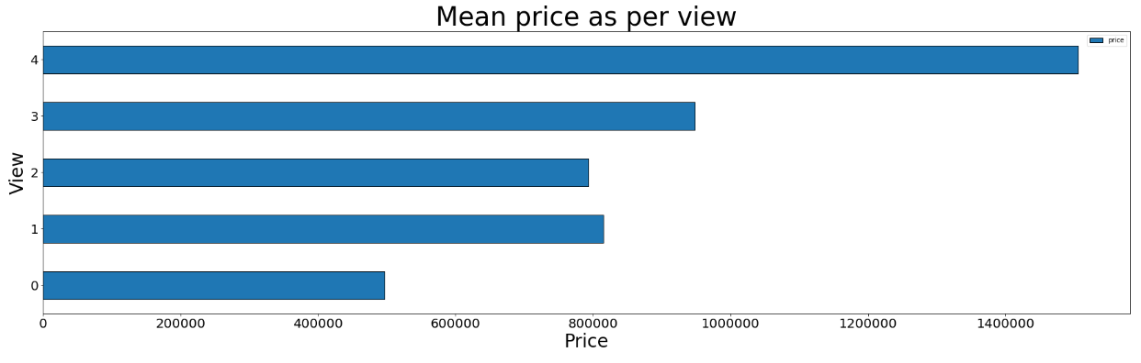
Analysis of View
View | Counts
0 | 8748
1 | 160
2 | 454
3 | 243
4 | 156
Correlation- 0.4
As view gets better, price increase

Slide 21
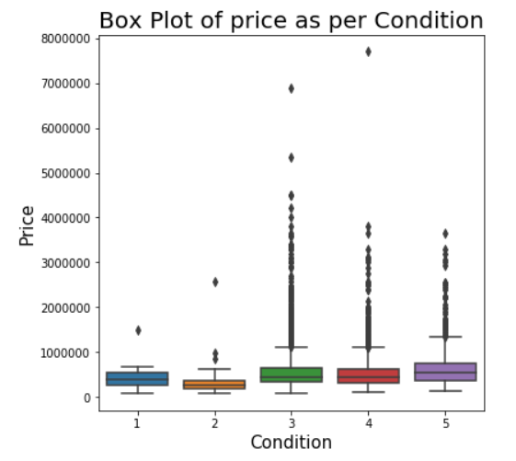
Analysis of Condition
Condition | Counts
1 | 10
2 | 78
3 | 6291
4 | 2610
5 | 772
For condition we will check with trial and error as we cannot see any relation from the correlation directly. We can do one
#hot encoding and check if it is helping in improving the performance of the model
Correlation- 0.04

Slide 22
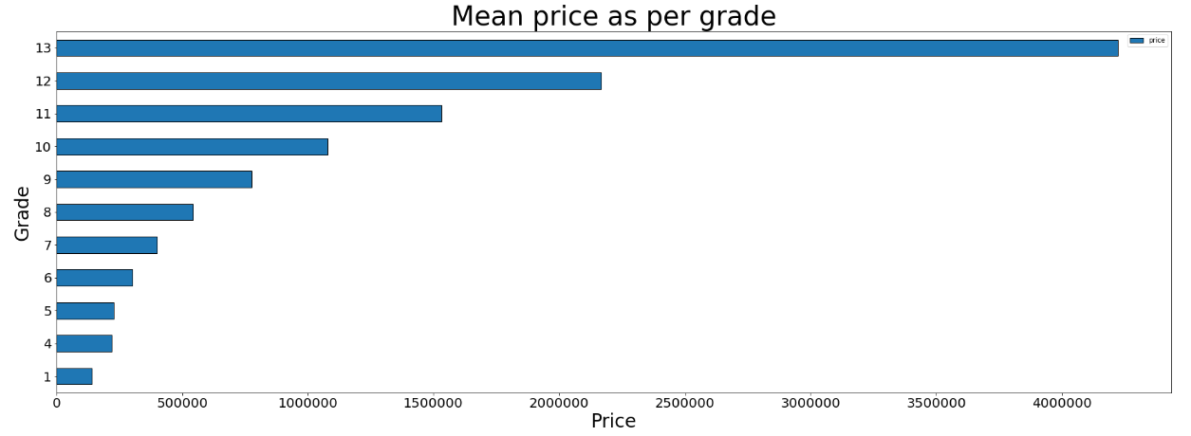
Analysis of Grade
Correlation- 0.4
As Grade increases, price increases

Slide 23
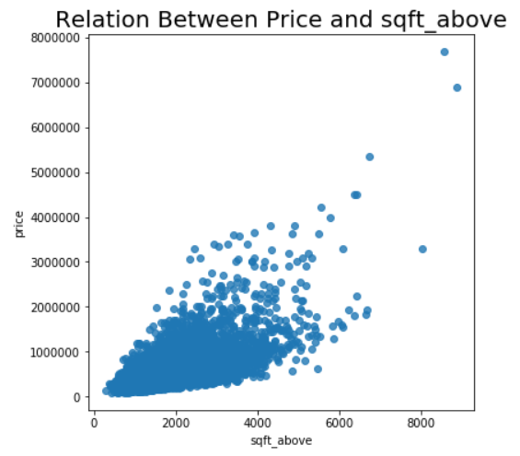
Analysis of square feet above
Correlation- 0.61

Slide 24
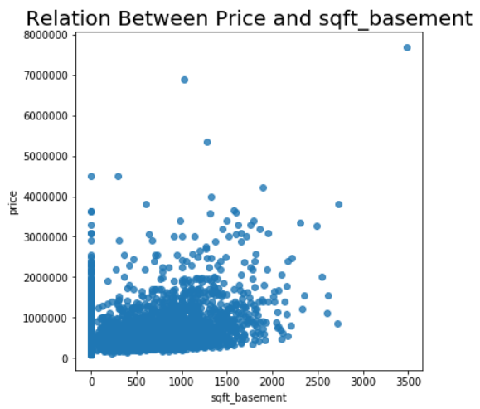
Analysis of square feet Basement
Correlation- 0.32
Note- Square feet basement and square feet above sumps up to give square feet living. So we have to check the behaviour of this predictors on our model.

Slide 25
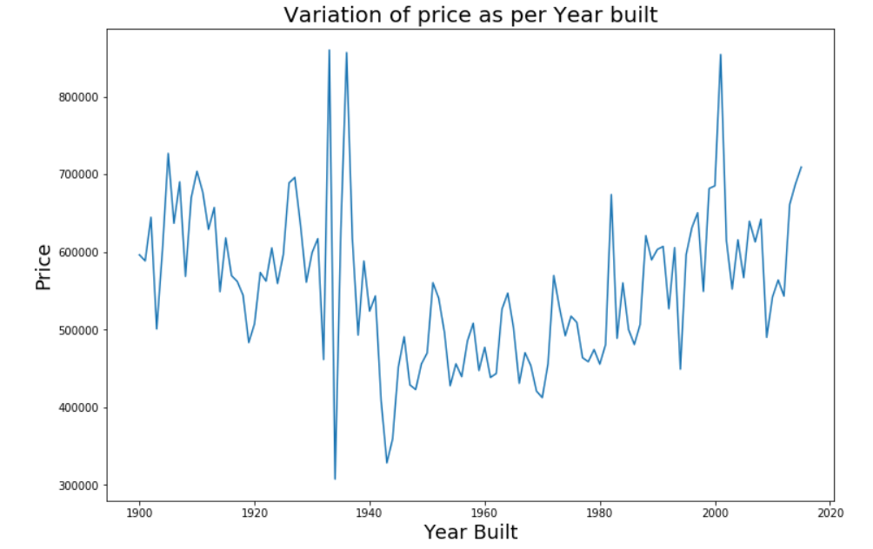
Analysis of Year Built
We can see a steady rise in price after 1945

Slide 26
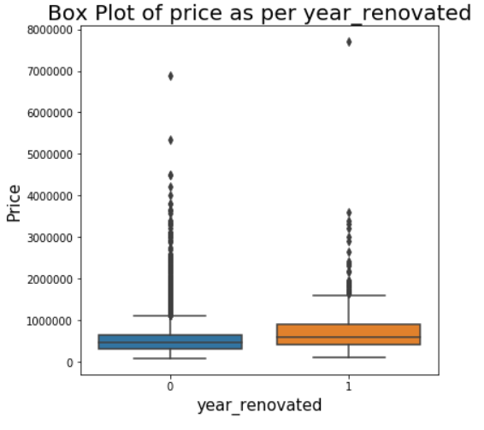
Analysis of Year Renovated
Converting the year renovated as a categorical variable where 1 tells that the house was renovated and 0 tells that the house was not renovated
Year_renovated | Count
0 | 9340
1 | 421
Year_renovated | Mean Price
0 | 533156.7
1 | 757517.8
For year renovated 1, the mean is high

Slide 27
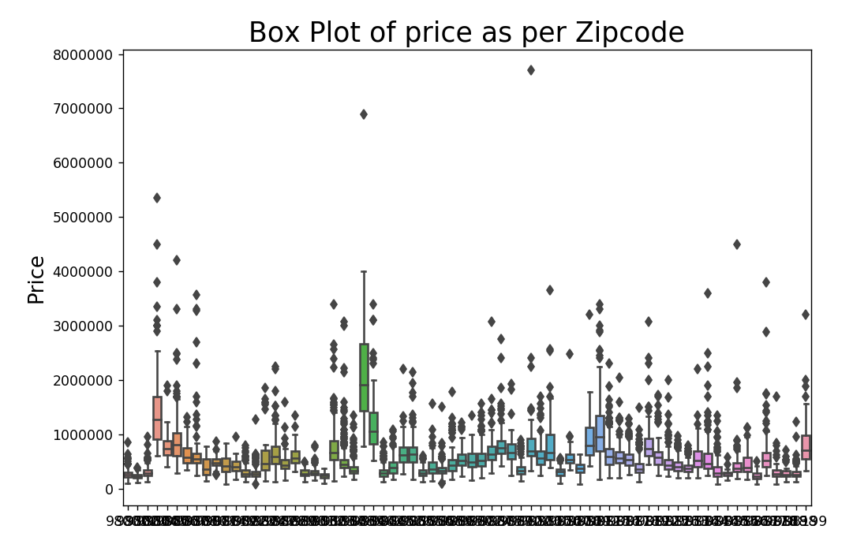
Analysis of Zipcode
We can see the variation in medians with respect to Pincodes.
We can try one hot encoding and check if it is helping us to improve the accuracy of the Model

Slide 28
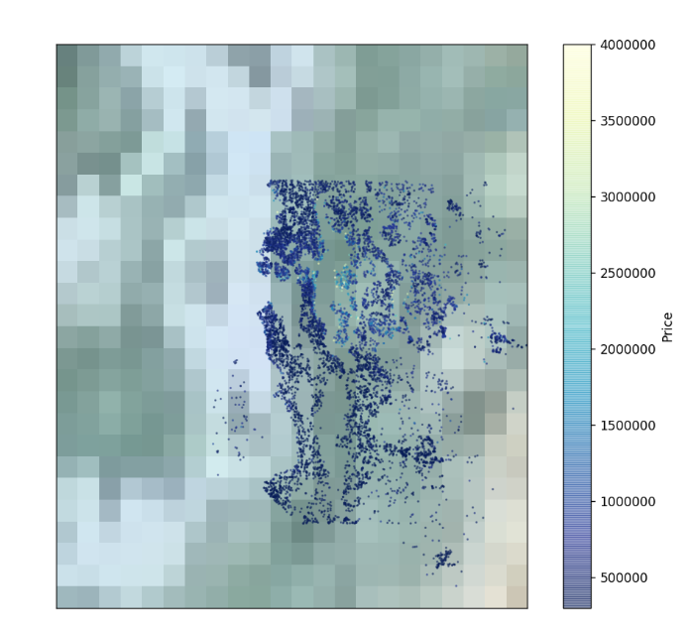
Analysis of Lat Long
I have tried to see some pattern of price with respect to Lat and Long using Python - Basemap
It is very hard to see any pattern of price using Lat and Long.

Slide 29
Chapter- 04
Model Building

Slide 30
Analysing the performance of the Model Using different Predictors
Predictors | RMSE | R^2 | Adjusted R^2
sqft_living | 255535.76 | 0.485 | 0.485
sqft_living, bedrooms | 251659.27 | 0.5 | 0.5
sqft_living, bedrooms,view | 241211.10 | 0.541 | 0.541
sqft_living, bedrooms,view,Grade | 231237.78 | 0.578 | 0.578
sqft_living, bedrooms,view,Grade, sqft_above | 230426.09 | 0.581 | 0.581
sqft_living, bedrooms,view,Grade, sqft_above, yr_built | 216522.24 | 0.63 | 0.63
sqft_living, bedrooms,view,Grade, sqft_above, yr_built, waterfront | 211837.14 | 0.646 | 0.646
sqft_living, bedrooms,view,Grade, sqft_above, yr_built, waterfront, zipcode | 159028.99 | 0.8 | 0.79
sqft_living, bedrooms,view,Grade, sqft_above, yr_built, waterfront, zipcode,Floors | 157292.6 | 0.804 | 0.803

Slide 31
Testing the best model on Test Data
List of Variables Used-
sqft_living
Bedrooms
View
Grade
sqft_above
yr_built
Waterfront
Zipcode
Floors
Parameters | Values
RMSE | 153534.80
R Square | 0.816
Adjusted R Square | 0.82
Code Link - https://github.com/indrajit3260007/Machine-Learning-1st-Term-Break-Assignment/blob/master/Code/term%20break%20assignment%20.ipynb

Slide 32
Conclusion
From the Model and its Performance using different predictors, we can conclude that any house’s cost depends largely on Area(Zip code) and the Area of the House.
But we should not forget that Price is also dependent on many other factors like the Financial status of the Country which is not included in the data.

Slide 33
Thanks!

